Slide 1
Student Portfolio
STUDENT NAME: S.SARANYA
REGISTER NOAND NMID: 241320618025222070 and asanm20624132061802522070
DEPARTMENT: B.Sc. - Computer Science
COLLEGE: THIRU A.GOVINDASAMY GOVERNMENT ARTS COLLEGE/ ANNAMALI UNIVERSITY

Slide 2
PROJECT TITLE
Creative Student Portfolio using FWD

Slide 3


AGENDA
Problem Statement
Project Overview
End Users
Tools and Technologies
Portfolio design and Layout
Features and Functionality
Results and Screenshots
Conclusion
Github Link
3/21/2024 Annual Review

Slide 4

PROBLEM STATEMENT
In today’s Digital era, traditional resumes are not enough to showcase Skills and projects effectively. Many Students and professionals lack a structured online presence to highlight their work. A digital portfolio provides an interactive and accessible platform to present achievements, skills and experience.

Slide 5

PROJECT OVERVIEW
Abot My Project : A digital portfolio that contain all my personal and professional details in an accessible manner.
My portfolio contains : About me, My work, Projects, Skills and Contact details.
Main idea of this project: To showcase the Personal achievements, skills, Projects in digitally accessible manner.

Slide 6

WHO ARE THE END USERS?
Students (to showcase their technical knowledge and projects)
Professionals ( To Highlight their Professional experience and achievements)
Job seekers (to share with recruiters)
Freelancers ( to show clients)

Slide 7

TOOLS AND TECHNIQUES
HTML :- Structure (pages, sections)
CSS :- Styling (Colour, layouts, responsiveness)
JavaScript :- Interactivity (Navigation menu, animations, form validation)
Code Editor: - CODEPEN ; Hosting platform : GitHub pages

Slide 8
POTFOLIO DESIGN AND LAYOUT
Sections Included:
Home: My introduction and description about my education, responsive View my work tab provided.
About Me: My profile photo included along with tagline of my vision statement.
My Projects: My list of projects provided as digital grid(responsive tab)
No of projects – 3. namely – Project 1, Project 2, Project 3.
Contact me: Responsive navigation bar using JavaScript is provided
With three input elements (Your name, Gmail, Your message) and send tab provided by using HTML and JavaScript.
User can enter their Name, Gmail, written message.
8

Slide 9
FEATURES AND FUNCTIONALITY
Navigation bar with smooth scrolling
Personal detail showcase with image/details
Interactive elements (hover effects, animation)
Contact form (with Validation)
Responsive Design for all Devices

Slide 10
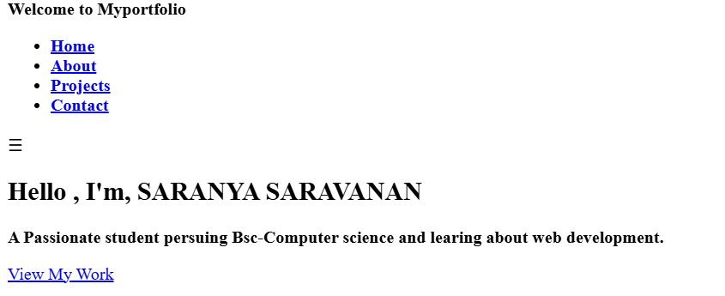

RESULTS AND SCREENSHOTS
Plain HTML with CSS and JS
BEFORE: Plain HTML without CSS and JS
3/21/2024 Annual Review
10

Slide 11
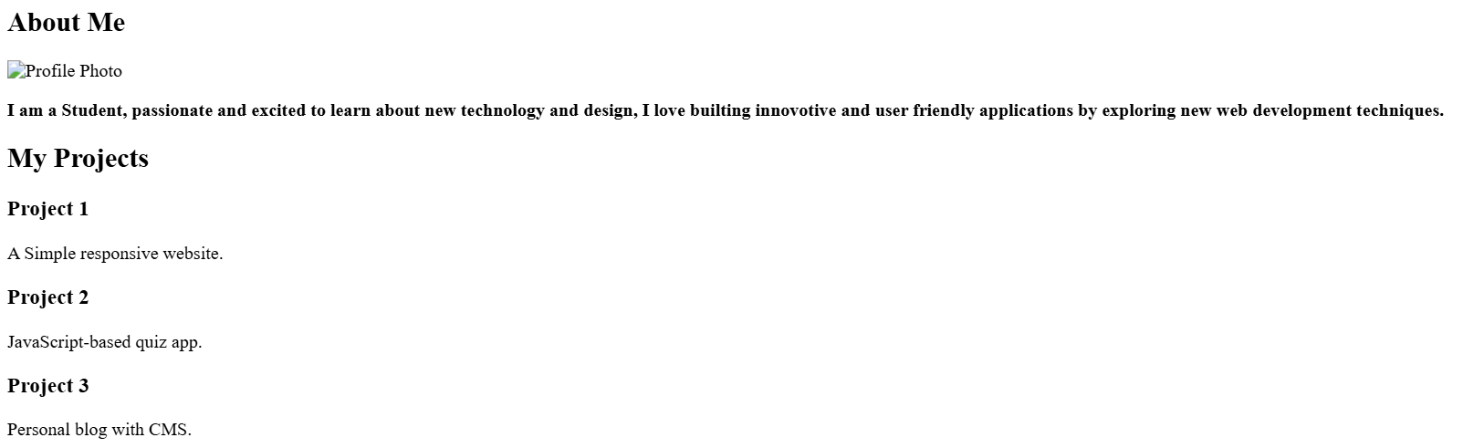
RESULTS AND SCREENSHOTS
Plain HTML with CSS and JS
BEFORE: Plain HTML without CSS and JS
3/21/2024 Annual Review
11

Slide 12
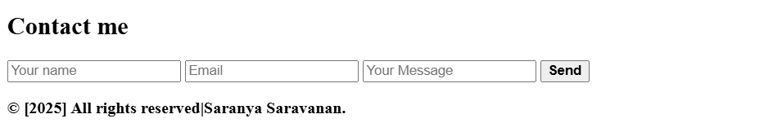
RESULTS AND SCREENSHOTS
Plain HTML with CSS and JS
BEFORE: Plain HTML without CSS and JS
3/21/2024 Annual Review
12

Slide 13
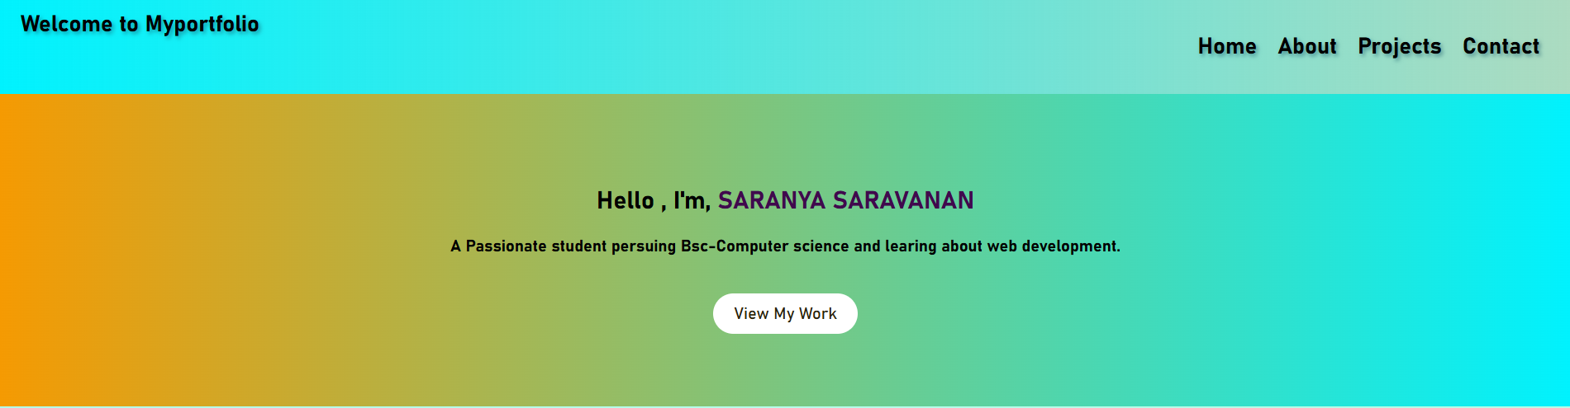
RESULTS AND SCREENSHOTS
Plain HTML with CSS and JS
AFTER: HTML with CSS and JS
3/21/2024 Annual Review
13

Slide 14
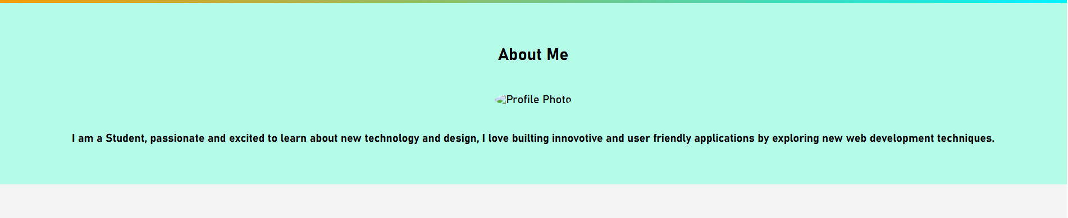
RESULTS AND SCREENSHOTS
Plain HTML with CSS and JS
AFTER: HTML with CSS and JS
3/21/2024 Annual Review
14

Slide 15
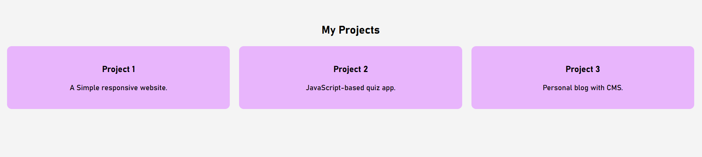
RESULTS AND SCREENSHOTS
Plain HTML with CSS and JS
AFTER: HTML with CSS and JS
3/21/2024 Annual Review
15

Slide 16

RESULTS AND SCREENSHOTS
Plain HTML with CSS and JS
AFTER: HTML with CSS and JS
3/21/2024 Annual Review
16

Slide 17
CONCLUSION
Digital Portfolio with Interactive tools is effective and user friendly
Easy access and smooth user interface
Quicker responsive
Benefits to the society: This Digital Portfolio will be essential tool for jobseekers to showcase their over all experience and projects highlights in a digital manner to seek more attention from recruiters
17

